Slide 1
JOSEPH BRIDGER THE KING’S HENCHMAN OR THE GOVERNOR’S VERY USEFUL MAN
By Janet Morgan Ross
December 2021

Slide 2
Joseph Bridger
Qualifying Ancestor A1108: Councillor of State 1670-1686
Burgess for Isle of Wight Co., VA: 1657-1658, 1663, 1666

Slide 3
Joseph Bridger
Baptized 28 April 1631, Dursley, Gloucestershire, England, as Josephus, filis Samuelis Bridger [photo of baptismal record]. He was likely born at Woodmancote Manor in Dursley, a house that his grandfather Lawrence Bridger originally purchased .
Died 15 April 1686, Isle of Wight Co., VA, buried Whitemarsh Farm, Isle of Wight Co., VA, perhaps of lead poisoning(?).
Remains removed from Whitemarsh Farm in the 1890s when the farm was sold out of the family and reburied in the chancell of St. Luke’s Church, Smithfield, Isle of Wight Co., VA

Slide 4
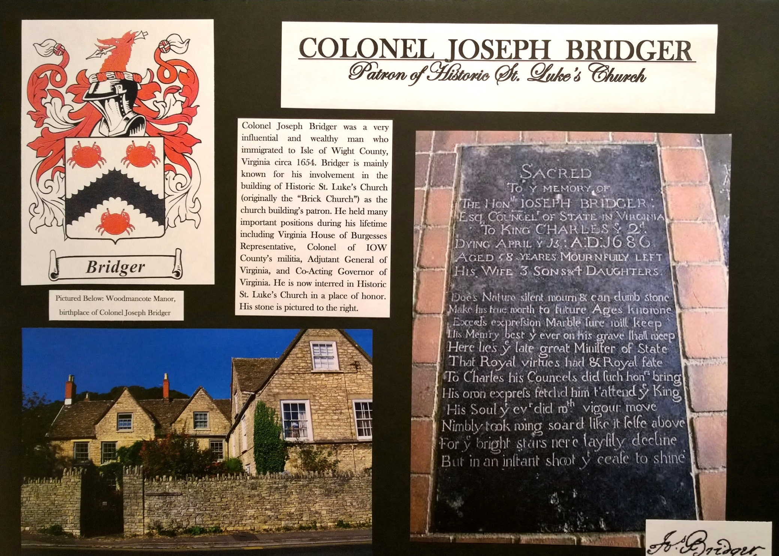

Slide 5
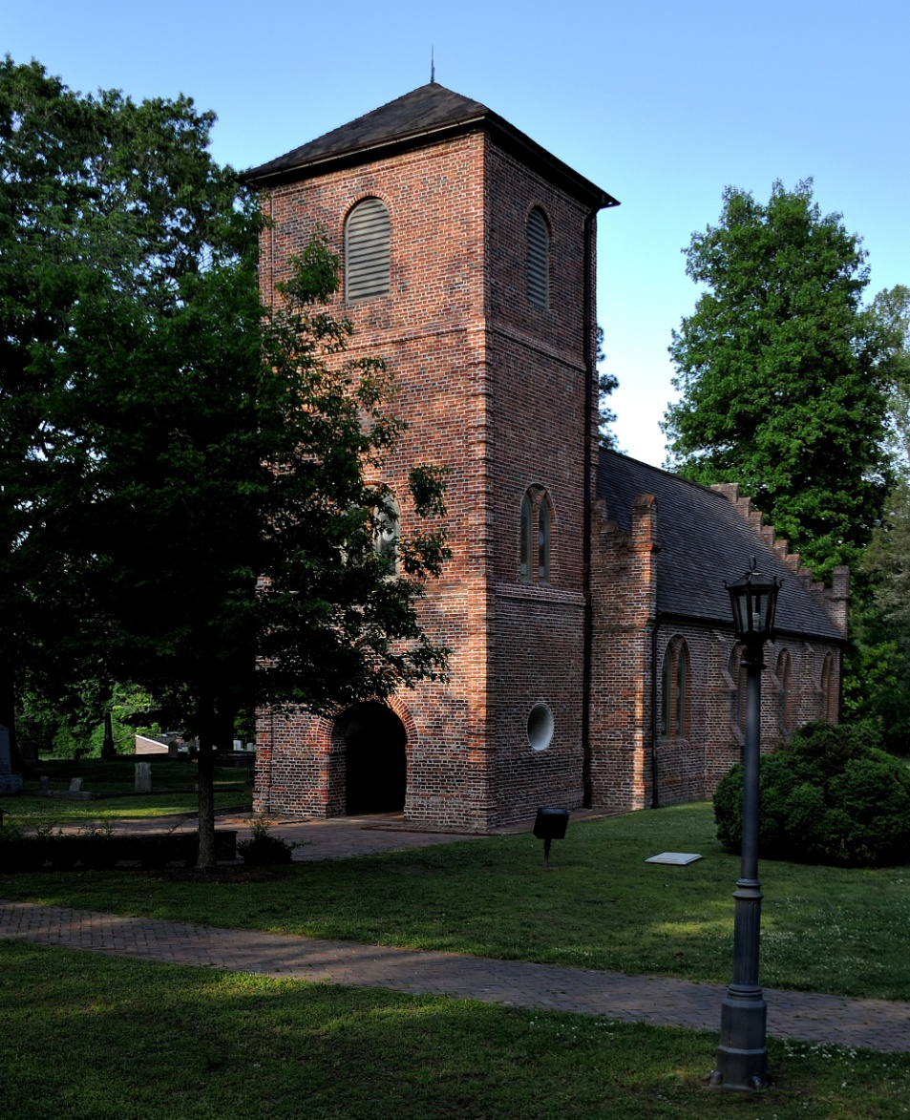
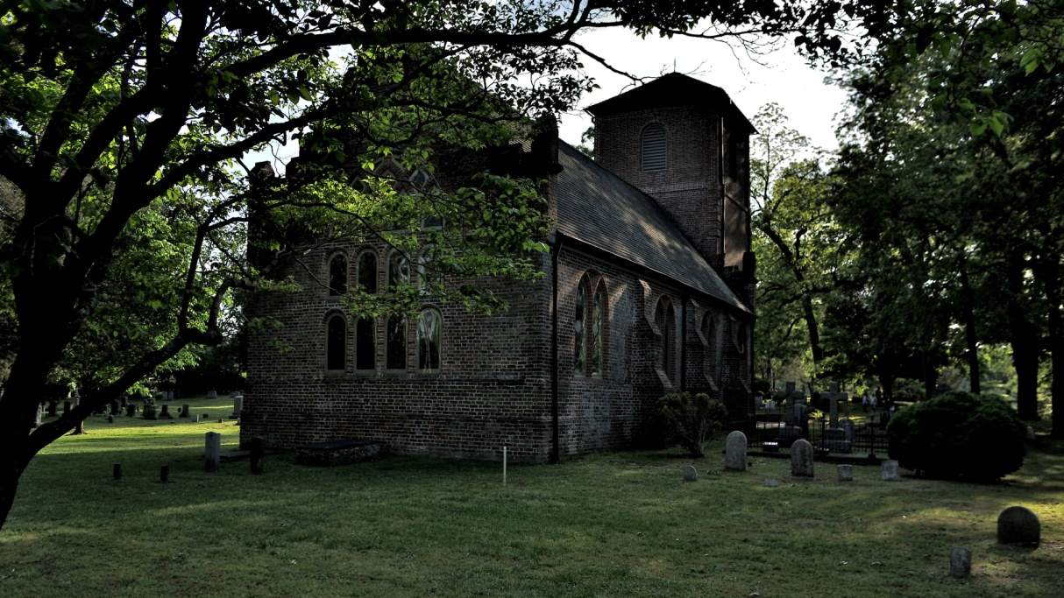
Historic St. Luke’s Church Smithfield, Isle of Wight County, VA

Slide 6
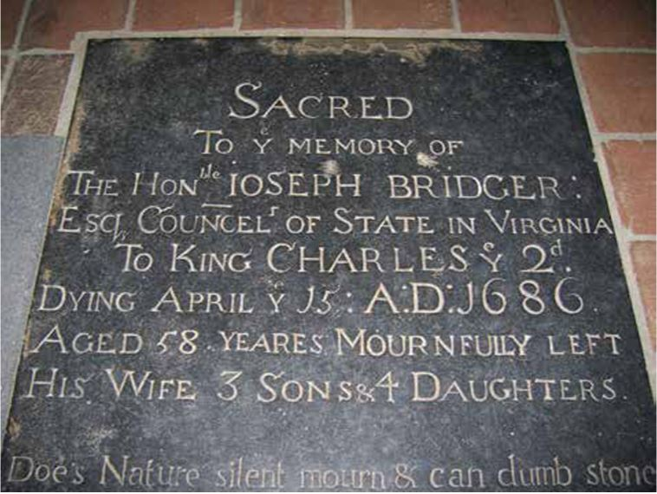
Ledger Stone in Historic St. Luke’s Church

Slide 7
Joseph Bridger
Married about 1654 likely in Isle of Wight Co., VA, to Hester Pitt, daughter of Robert Pitt, Merchant of Bristol, England, and Isle of Wight Co., VA
Robert Pitt is Qualifying Ancestor A6208: Burgess for Isle of Wight Co., VA, 1649, 1652-1655, 1659-1662)
In 1654, Hester would have been 18 years old and Joseph 23. He and Hester would have 7 children, 3 sons and 4 daughters.

Slide 8
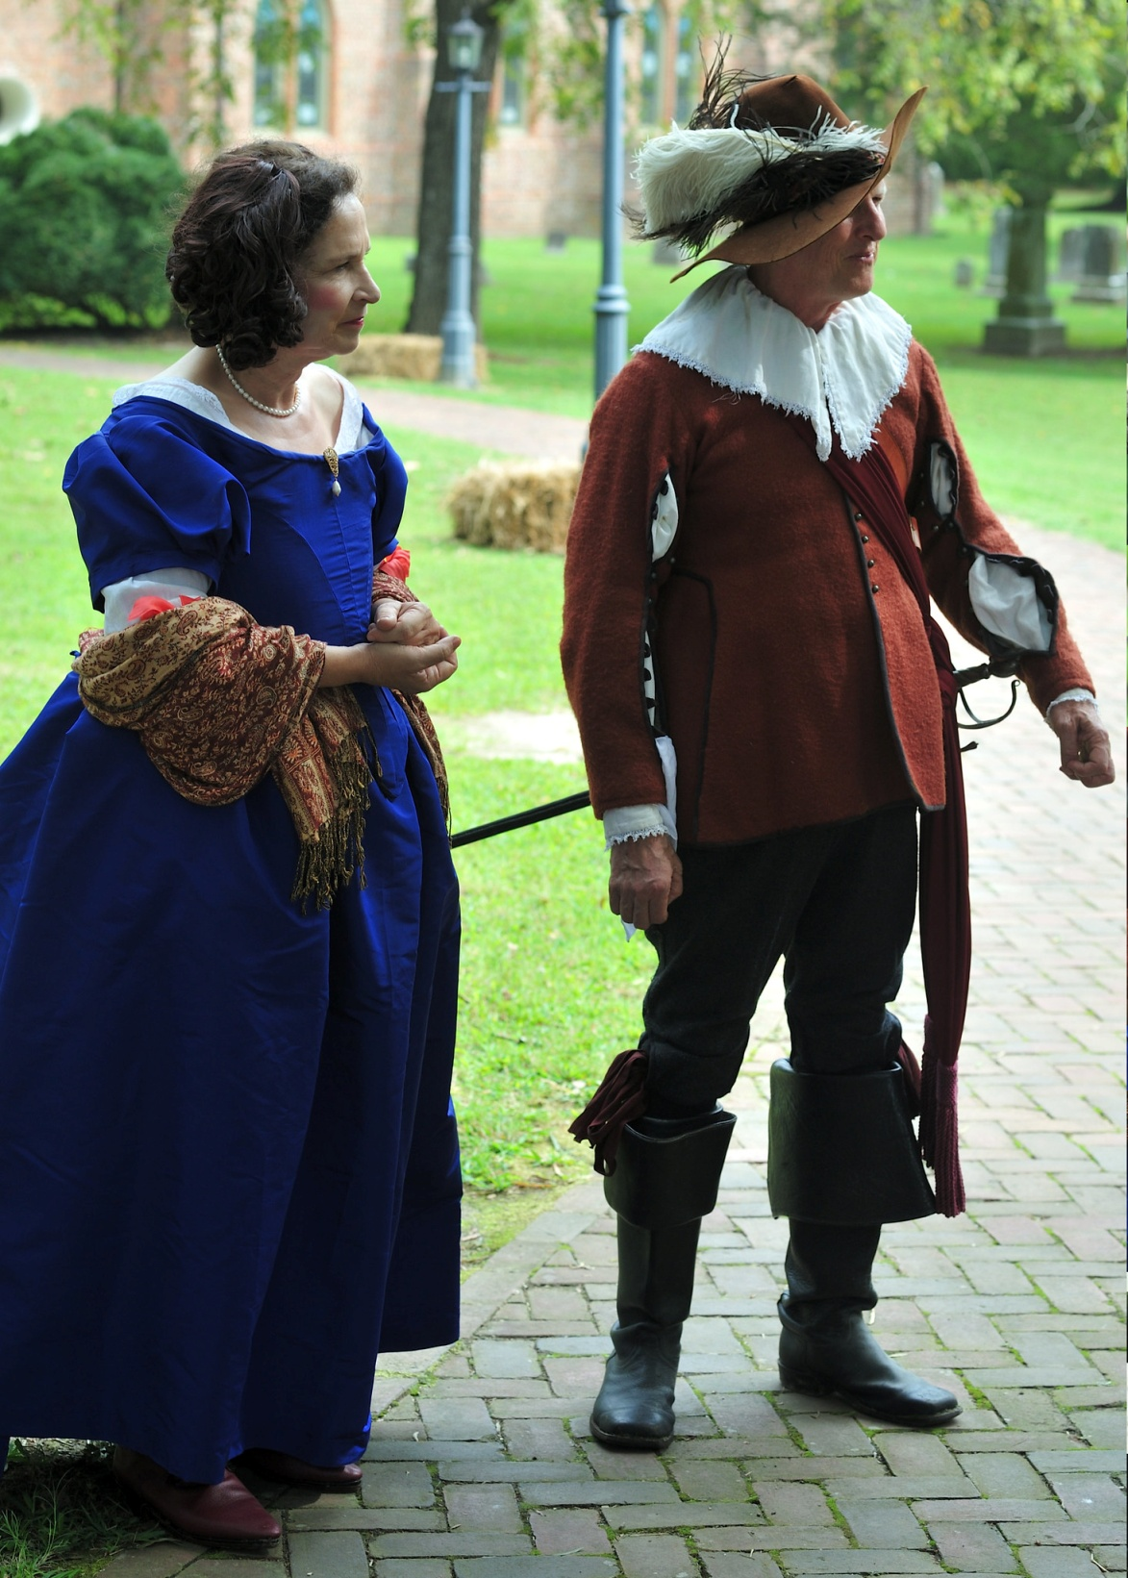
Hester Pitt and Joseph Bridger at Historic St. Luke’s Church 10 Sep 2016

Slide 9
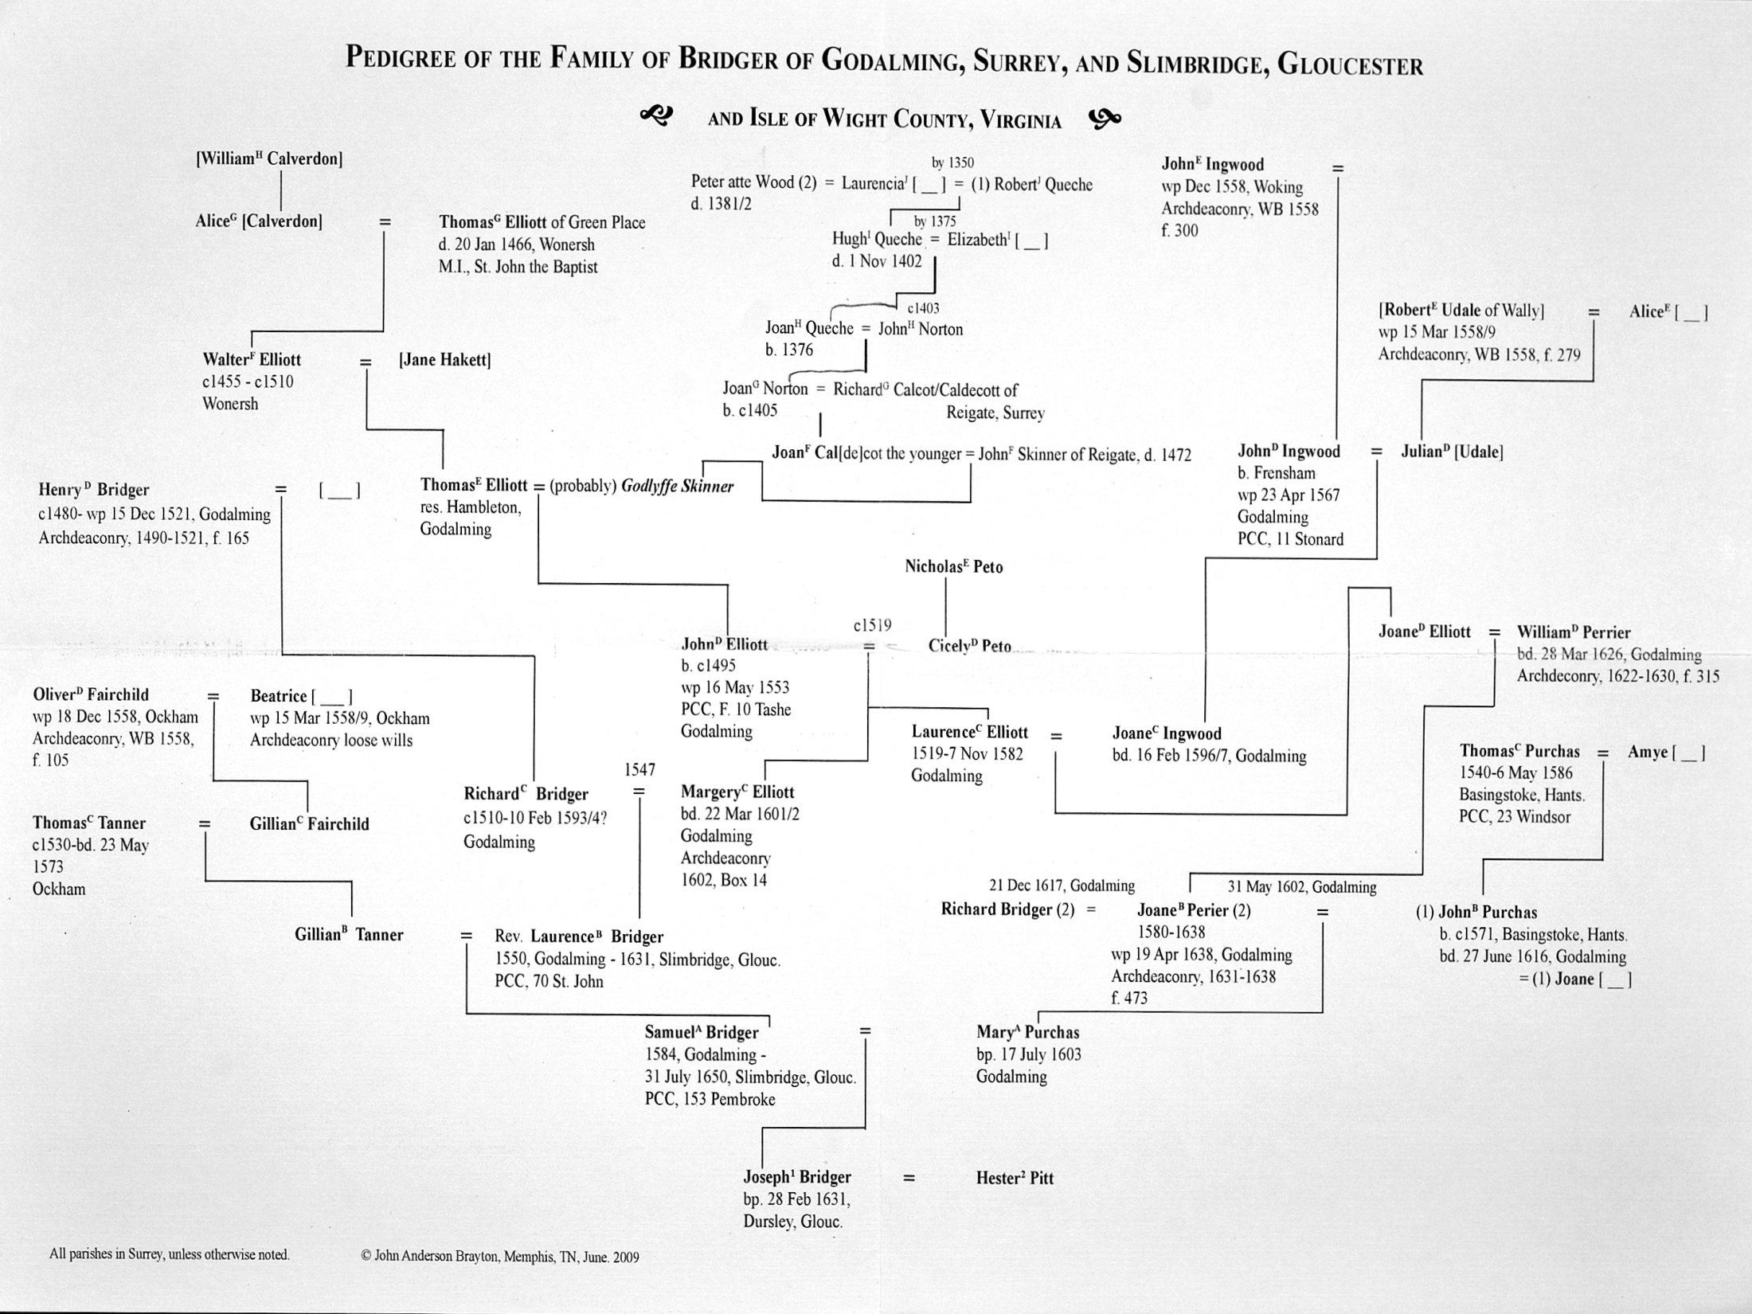

Slide 10
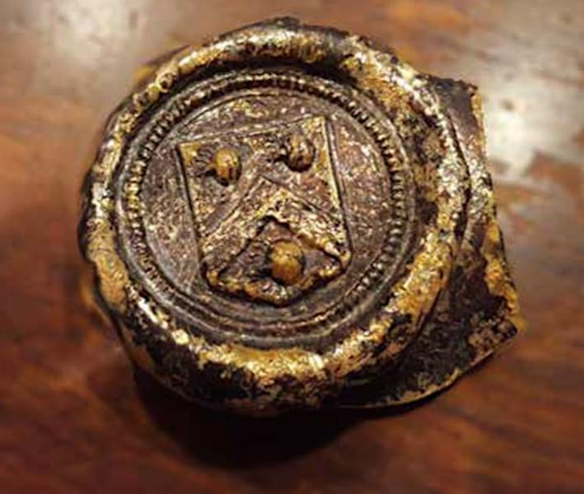
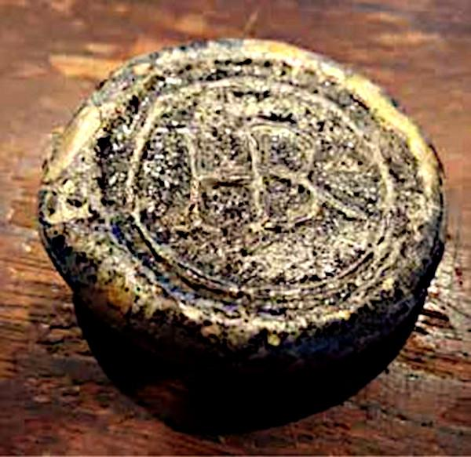
The Success of London delivered a cargo of wines and other goods to Joseph Bridger of Virginia in 1654 [1673 quit claim] Wine seals for Joseph and Hester [photos from Historic St. Luke’s Magazine]

Slide 11
Political and Military Careers
Family tradition says that Joseph Bridger was a soldier in the Royal Army during the English Civil War. If so, given his birth date, he would have served in the Second Civil War in 1648.
House of Burgesses for Isle of Wight Co., VA: 1657-1658, 1663, 1666

Slide 12
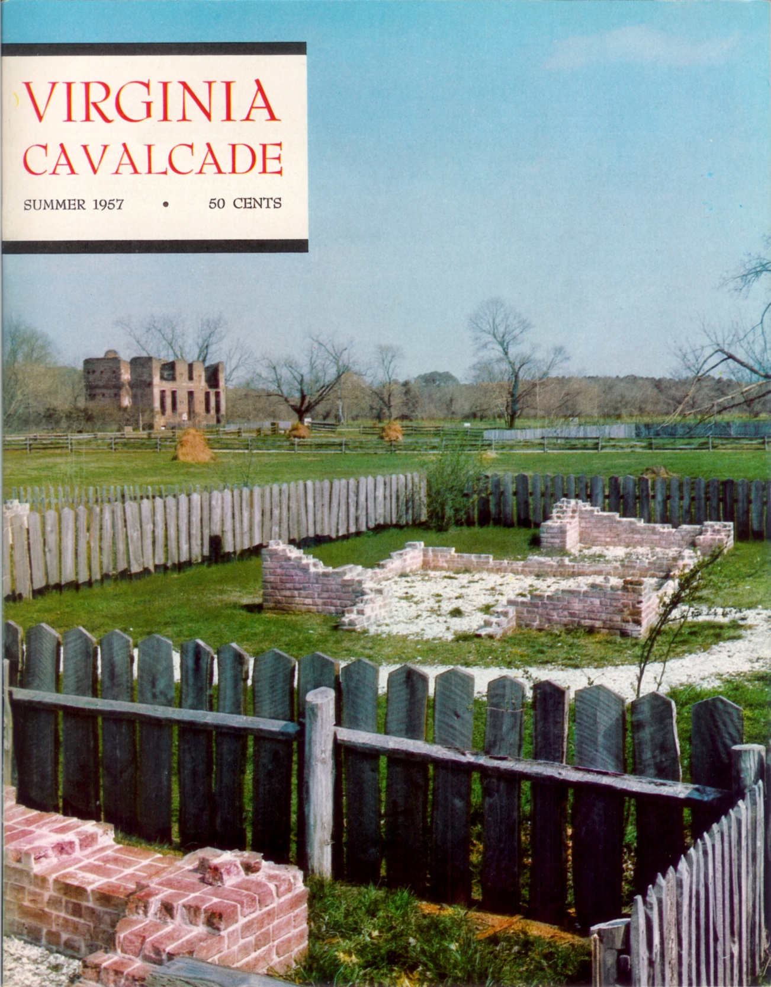
Joseph Bridger was the subject of The King’s Henchman, by Elmer Oris Parker, Virginia Cavalcade, Vol VII, #1, Summer 1957

Slide 13
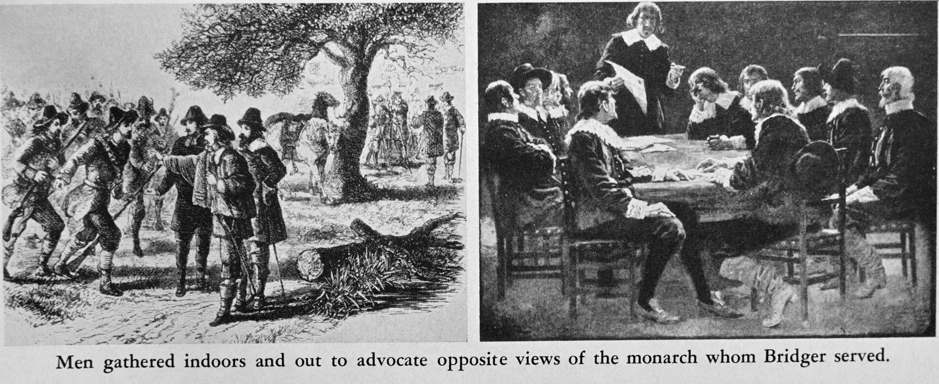
Political and Military Careers Councillor of State: 1670-1686 [Illustrations from Virginia Cavalcade, 1957]

Slide 14
Political and Military Careers
Adjutant General for Virginia in 1666
Colonel in the Isle of Wight Co., VA, beginning in 1672
During Bacon’s Rebellion, he was one of 5 Councillors to flee to Maryland’s eastern shore with Gov. Berkeley

Slide 15
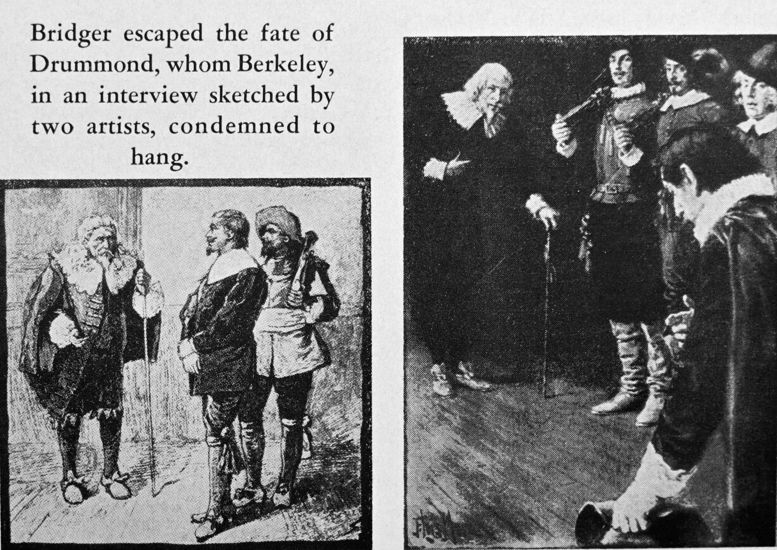
Joseph Bridger likely fought against the rebels during Bacon’s Rebellion [Illustrations from Virginia Cavalcade, 1957]

Slide 16
Political and Military Careers
Sole commander against the Indians in 1680 for 9 Counties (Lower Norfolk, Nansemond, Isle of Wight, Surry, Charles City, Henrico, New Kent, Rappahanock, and Potomeck?)
Deputy Vice Admiral for Virginia in 1683
Commander against the Indians in 1683 for all counties south of the James River, because, in Gov. Culpeper’s words, “the service is so difficult and dangerous that I could appoint no other.”

Slide 17
Joseph Bridger’s Wealth
Probably the wealthiest person living south of the James River in Virginia and probably one of the 10 wealthiest persons in Virginia. At his death, he was in debt to no one, and in fact, was “cash-rich,” a very rare thing in Colonial Virginia
Land: about 15,000 acres in Virginia and Maryland at his death in 1686 (He did not farm his land but instead leased it. He may have also owned a house in Jamestowne, but appears to have sold it before he died because it was not included in his inventory.)
Indentured Servants and Slaves: 4 indentured servants (two with only a year left to serve) and 13 slaves, with only 6 being adults or nearly so
House at Whitemarsh Farm or Plantation: a brick house with 21-rooms and approximately 11,300 square feet, as described in the inventory of his estate, which was one of the largest houses in Virginia at that time. The house burned twice and so only the foundation remained. Just for purposes of scale, George Washington’s Mount Vernon has 21 rooms and 11,008 square feet.

Slide 18
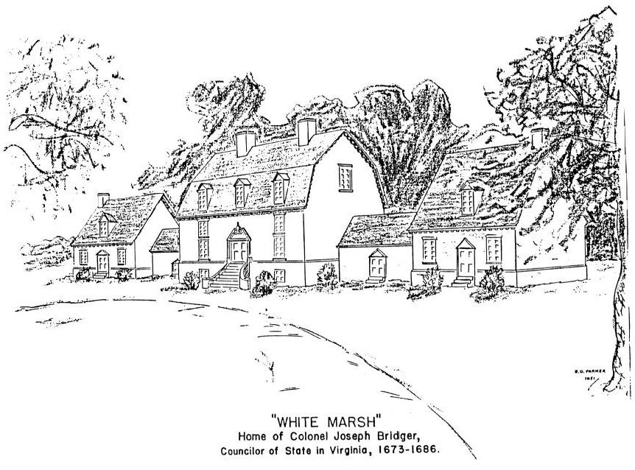
Whitemarsh Mansion pre-archeology concept by E. O. Parker

Slide 19
Expected New Reports on Joseph Bridger and Whitemarsh
Archaeology on Whitemarsh Farm that wrapped up in 2021, directed by Alain Outlaw and sponsored by St Luke’s Foundation
DNA from bones of Joseph Bridger, analysis directed by Doug Owsely

Slide 20
Main Sources
The Landed and Personal Estate of Gen. Joseph Bridger, by William P. Carrell II, by author, 2nd edition, Lexington, KY, 2007.
The Colonial Virginia Register, compiled by William G. and Mary Newton Stanard, Joel Munsell’s Sons Publishers, Philadelphia, 1902.
Colonial Families of Surry and Isle of Wight Counties, Virginia, vol. 7, The Pitt Family of Bristol, Gloucester, Charleston, Massachusetts and Isle of Wight County, Virginia, by John A. Brayton, by author, 2002
Colonial Families of Surry and Isle of Wight Counties, Virginia, vol. 10, Bridger of Godalming, Surrey; Slimbridge, Cloucestershire; and Virginia, by John A. Brayton, by author, 2009
Seventeenth Century Isle of Wight County, Virginia, by John Bennett Boddie, by author, 1938, Chicago, reprinted Genealogical Publishing, Baltimore, 1994.
“The King’s Henchman,” by Elmer Oris Parker, Virginia Cavalcade, vol. VII, #1, Summer 1957, pp. 34-37.

Slide 21
Minor Sources
Merchants and Merchandise in Seventeenth-Century Bristol, edited by Patrick McGrath, 2nd edition, Bristol Record Society’s Publications, vol XIX, 1968, p. 259. A digital version of this book is available through the Bristol Record Society (https://www.bristol.ac.uk/Depts/History/bristolrecordsociety/publications/brs19.pdf).
“Slimbridge and an American Connection,” by E. W. Carpenter, in Regional Historian, The Newsletter of the Regional History Centre at the University of the West of England, Bristol, #9, Summer 2002, pp. 13-17. A digital version is available (https://regionalhistorianuwe.org/).

